Slide 1
Die 5 Techniken der Wissenschaftsleugnung (PLURV)
Notes:
Science denial has five tell-tale techniques. They can be summarized with the acronym FLICC.

Slide 2
Die 5 Techniken der Wissenschaftsleugnung (PLURV)
Pseudo- Experten
crankyuncle.com
Notes:
Fake experts are people who convey the appearance of expertise without possessing any actual relevant expertise.

Slide 3
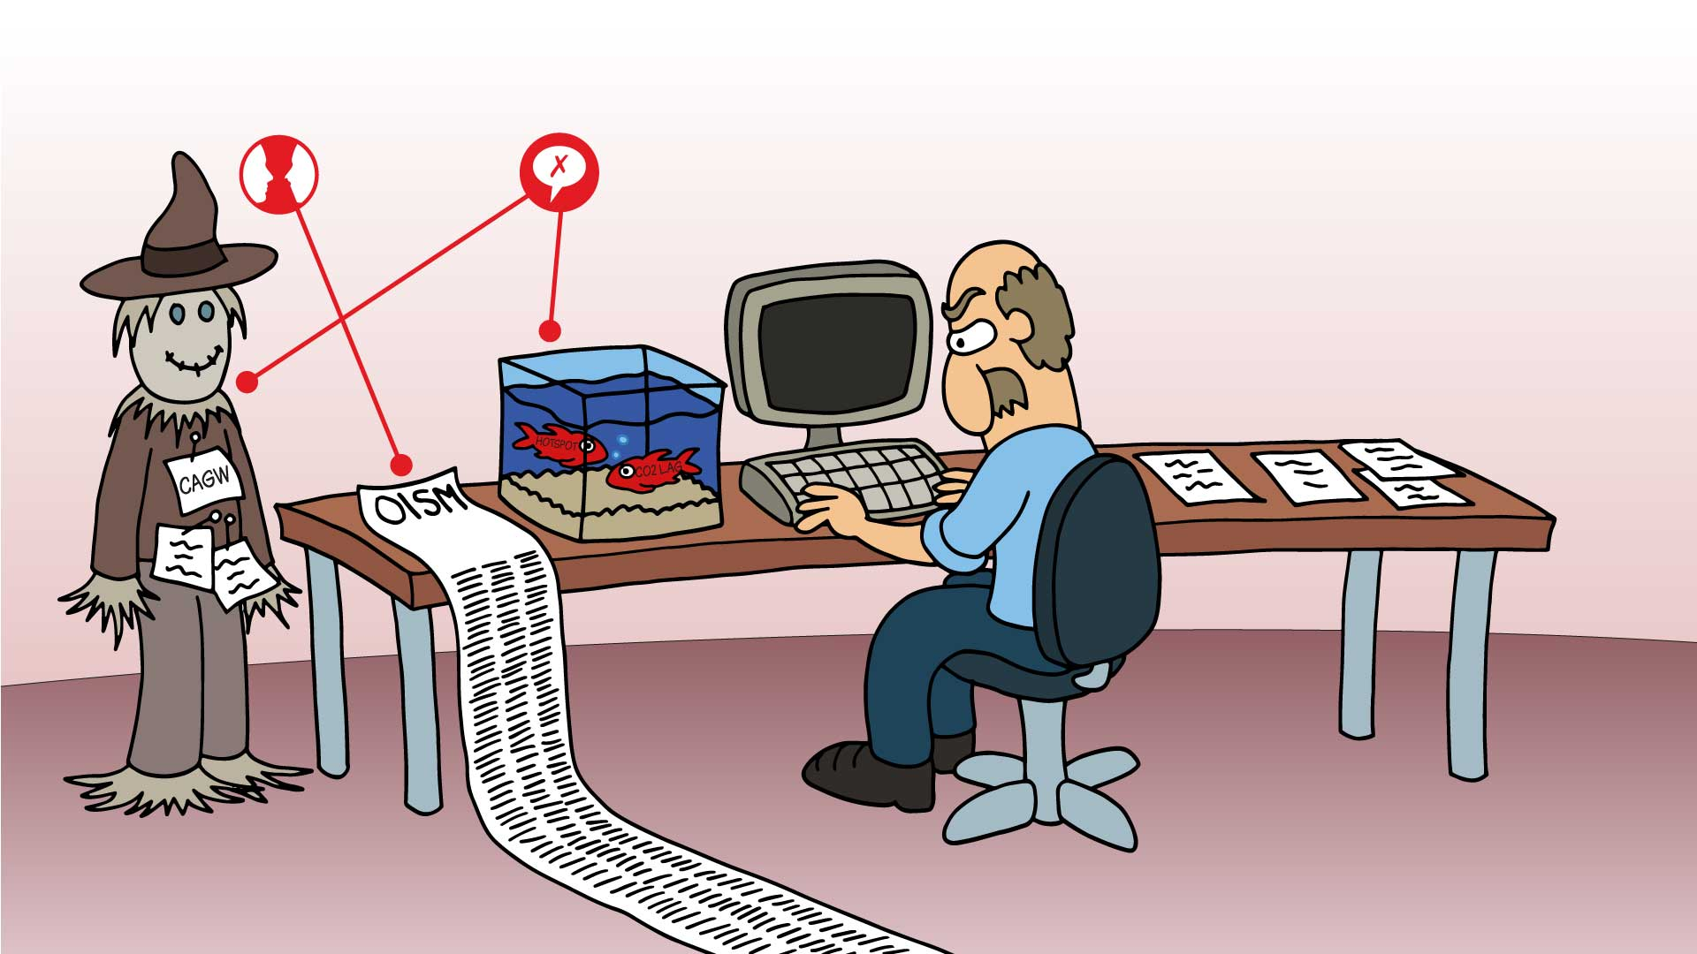
Die 5 Techniken der Wissenschaftsleugnung (PLURV)
Pseudo- Experten
Logische Trugschlüsse
crankyuncle.com
Notes:
Logical fallacies are false arguments leading to an invalid conclusion. There are a number of different fallacies— strawman and red herrings shown here are just two of commonly found denier arguments.

Slide 4
Die 5 Techniken der Wissenschaftsleugnung (PLURV)
Pseudo- Experten
Logische Trugschlüsse
Unerfüllbare Erwartungen
crankyuncle.com
Notes:
Impossible expectations demand unrealistic standards of proof before acting on the science.

Slide 5
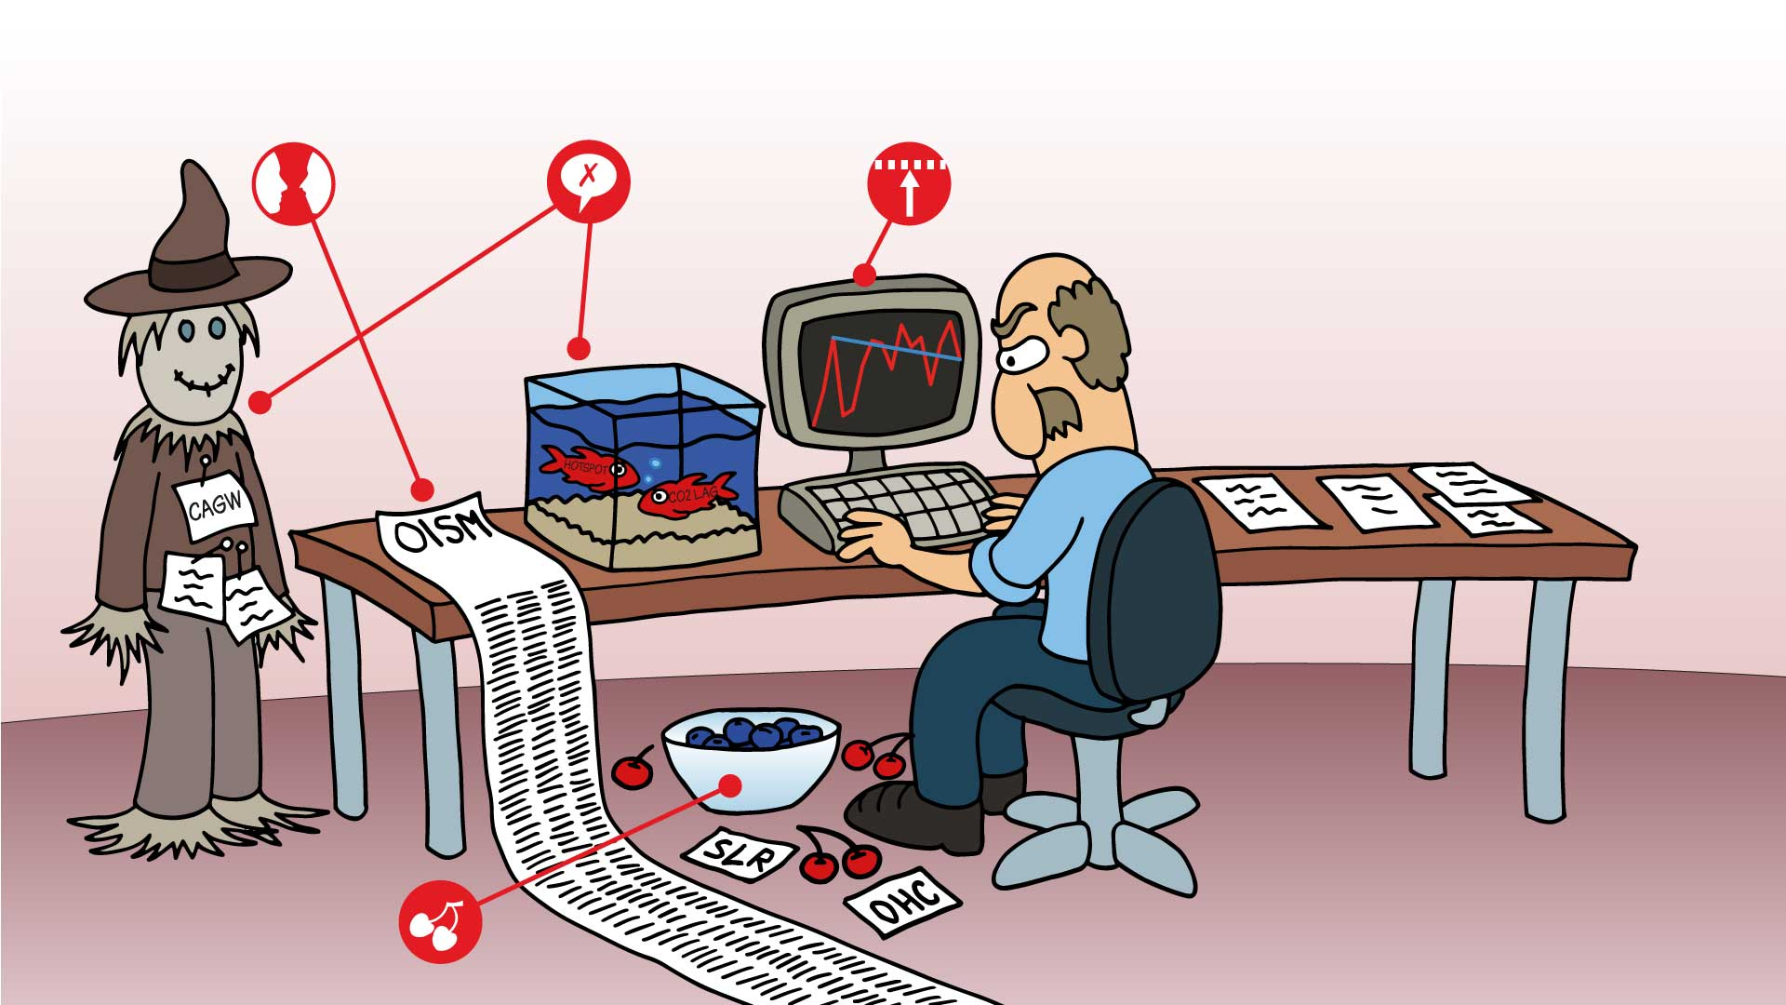
Die 5 Techniken der Wissenschaftsleugnung (PLURV)
Pseudo- Experten
Logische Trugschlüsse
Unerfüllbare Erwartungen
crankyuncle.com
Rosinen- pickerei
Notes:
Cherry picking involves focusing on select pieces of data while ignoring anything conflicting with the desired conclusion.

Slide 6
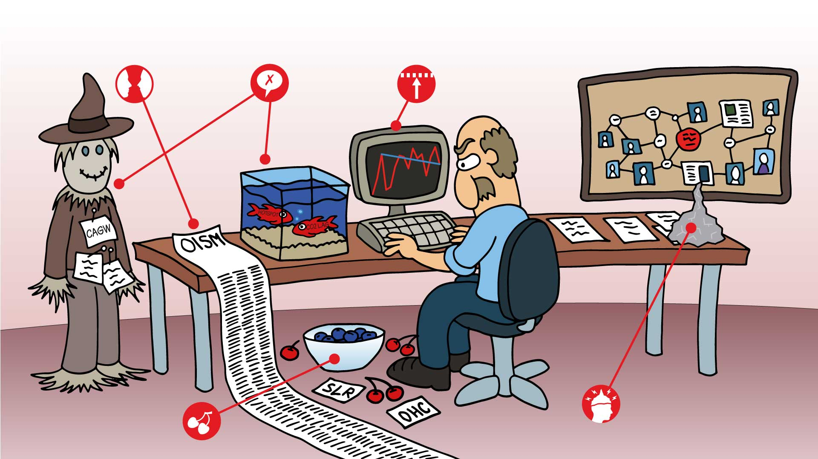
Die 5 Techniken der Wissenschaftsleugnung (PLURV)
Pseudo- Experten
Logische Trugschlüsse
Unerfüllbare Erwartungen
crankyuncle.com
Verschwörungs- mythen
Rosinen- pickerei
Notes:
Conspiracy theories are created when science deniers accuse the world’s scientists of a massive, global conspiracy.

Slide 20
